Slide 1
The Sphereoplex
Vibing out the dimensionality of affect

Slide 2
Text Embedding Models
Measures the semantic meaning of words
Input text -> output vectors
“this is a tree that I loved climbing as a child” ->
[ 0.01957703, -0.01119995, -0.00603867, 0.01118469, -0.01532745, -0.02481079, 0.01232910, 0.01969910, -0.04669189, 0.02142334, ... ]

Slide 3
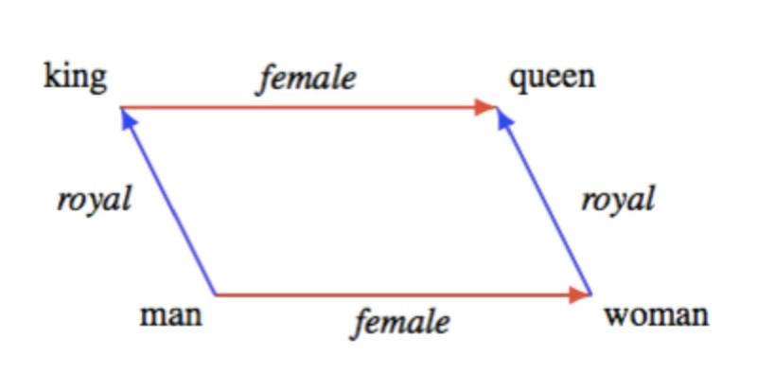
Text Embedding Models
Vectors are linearly composable!! (technically)

Slide 4
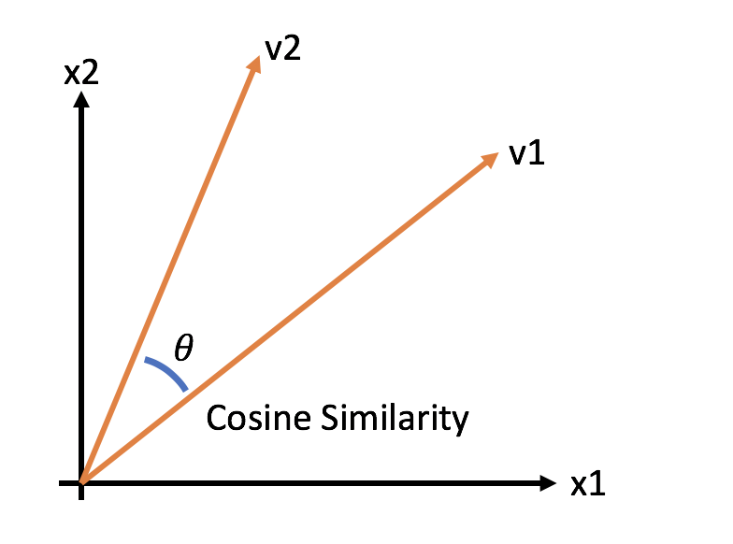
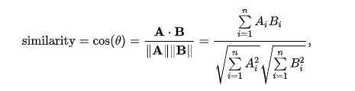
Cosine Similarity

Slide 5
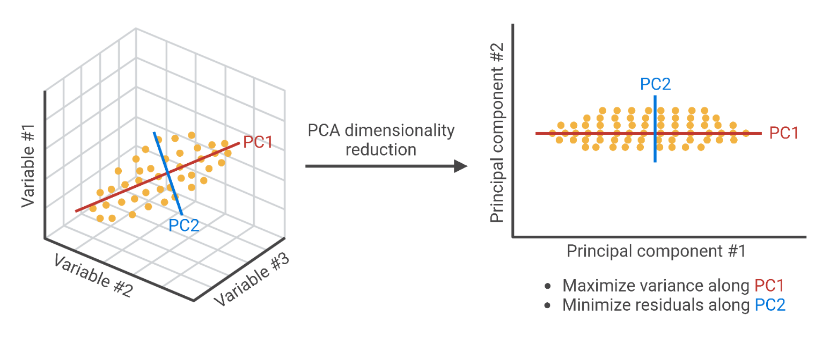
Principle Component Analysis
Embeddings are not 3 dimensional, they are 1536-dimensional
PCA “collapses” dimensionality into principal axes

Slide 6
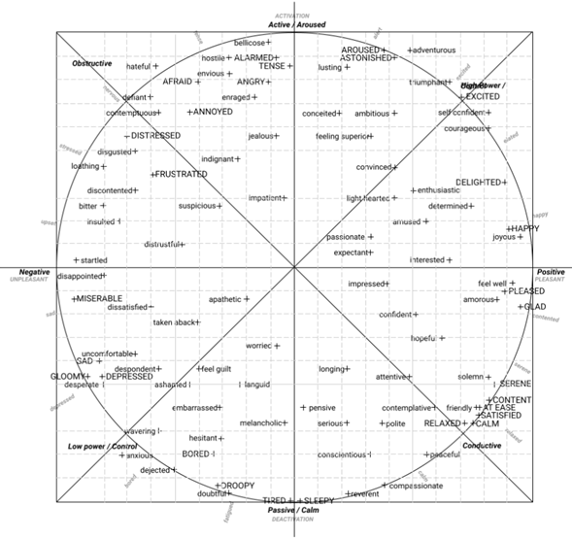
Russel’s Circumflex of Affect (1980)
2d graph of emotion
Neat
Cool

Slide 7
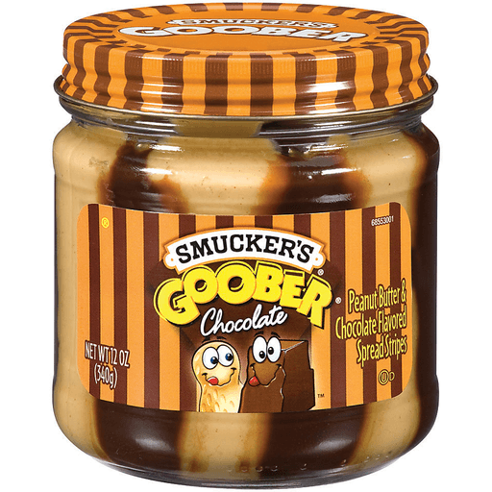
Shower thought time

Slide 8
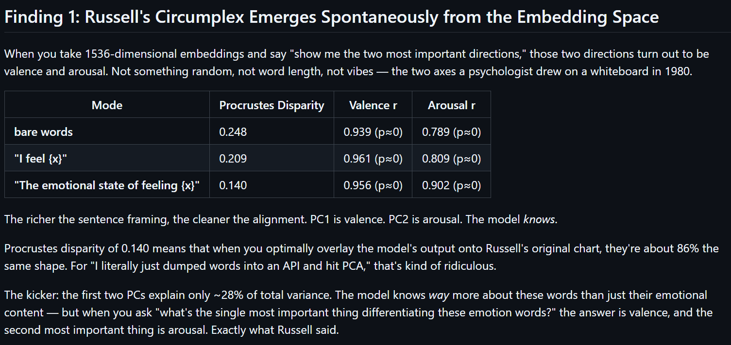
Setup

Slide 9
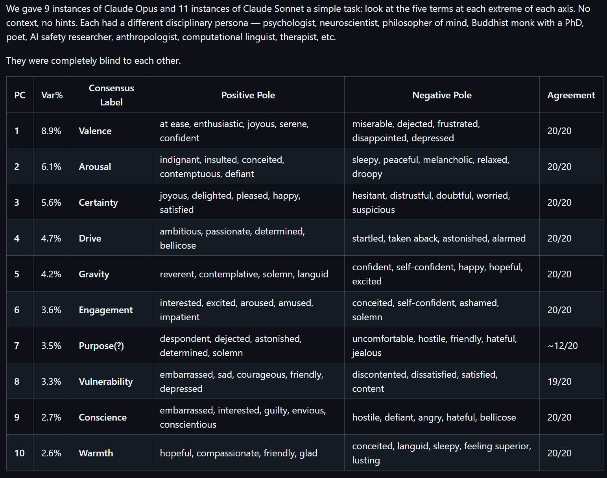
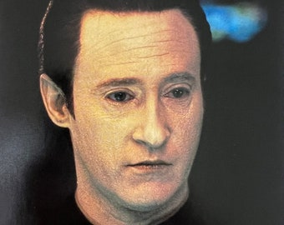
Data!!1
Data
Data

